Slide 1

DIGITAL DICE
Digital Logic Design Project

Slide 2
GROUP MEMBERS
ALI NADIR 20K-0325
IMTIAZ ALI 20K-0313
AHMED ABDULLAH 20K-0470
KANWAR MUZAMMIL 20K-0469

Slide 3
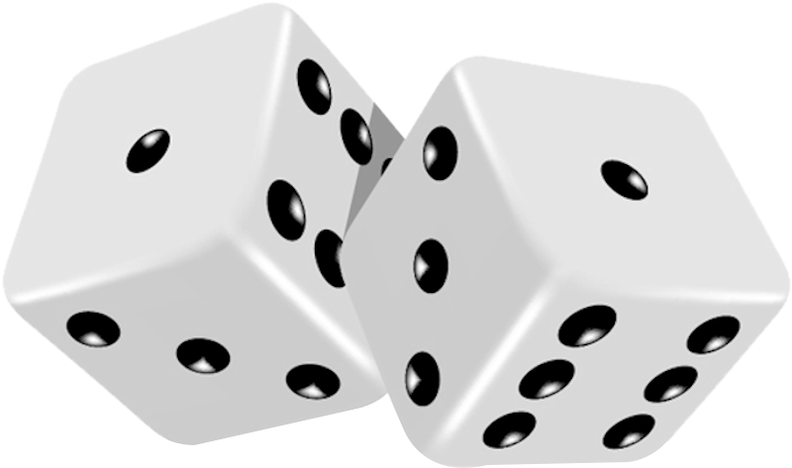
INTRODUCTION
This project aims to develop an electronic, randomized dice that is capable of generating any of the 6 possible resultant combinations (1 to 6) in the form of a matrix
The project also simulates the rolling/shuffling of the dice by means of a switch that enables randomized and unbiased pattern generation
The pattern generated is represented by
illuminated LEDs

Slide 4
MOTIVATION
What initiated this project was curiosity of the working and functionality of an electronic, hardware based random number generator. With this in view, a number of systems can be built to enable a particular pattern based on the random number generated. To implement such a system, a microcontroller capable of generating random numbers was needed. Since the project would use random numbers for processing, each number had to correspond to certain distinct output. In our case, this could be a group of LEDs coupled to resemble the faces of a die. Desire for exploration of the working of microcontrollers and its integration in random number generation, and eventually electronic dice, proved to be our main motivator. Thus, our group decided to create digitized dice for use in board games (ludo snakes and ladders etc.) and on a larger scale in digital signboard, matrix etc.

Slide 5
METHODOLOGY
The circuit can be categorized into 3 groups:
Astable Clock Pulse Generation
Pulse Counting
Translation of counted pulses into LED output

Slide 6
METHODOLOGY
Clock pulses are generated using an astable IC which constantly produces HIGH and LOW states
Incoming clock pulses are counted incrementally using a Johnson decade counter, of which 6 pins are routed through parallel combinations of resistors which are grouped in 4
The number of resistors to each pin of the counter show the number of outputs in a group(total 4)
The 4 groups represent the combinations of LEDs that must illuminate when a pattern is generated
Finally, these 4 groups of outputs are connected to LEDs by means of transistors

Slide 7
Electronic Components
1x 555 Timer IC for pulse generation
1x 4017 IC to receive and count pulses
9x LED for output
4x transistors: for amplification of current to the LEDs
5x 220K and 12x 10K resistors for surge protection
1x 1uF, 1x 0.01uF capacitors
1x push button
3 breadboards

Slide 8
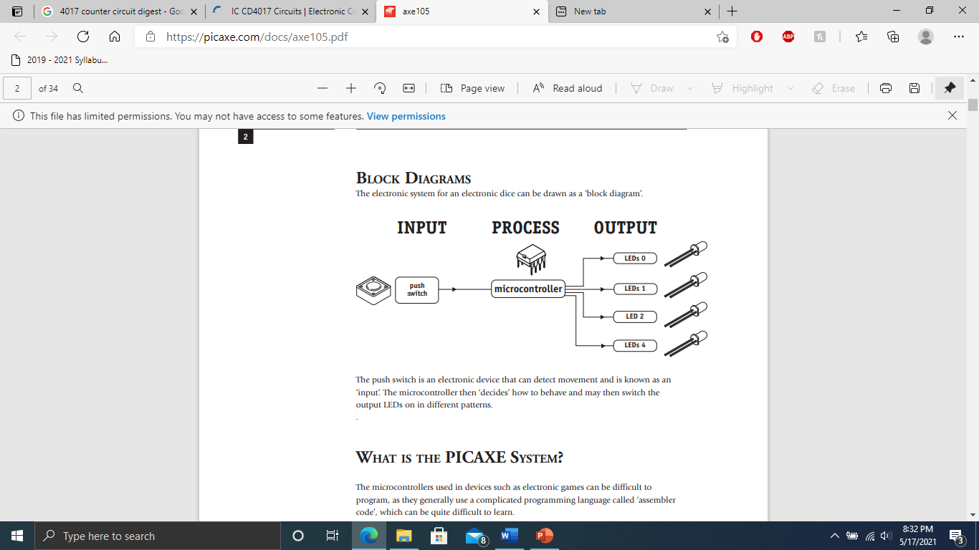
BASIC DESIGN
INPUT:
Push button used
PROCESS:
IC 4017
IC 555
OUTPUT:
LEDs
Transistors
Circuit Arrangement

Slide 9
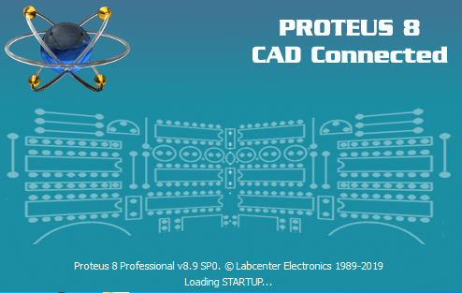
SOFTWARE
The software chosen for hardware circuit design, simulation, and testing is Proteus 8
Allowed for careful study of circuit for better understanding
Chosen for its rich library of electrical components, including various microcontrollers, and debugging tools, such as plotters and oscilloscopes
Easy to use and up to date with latest hardware conventions

Slide 10
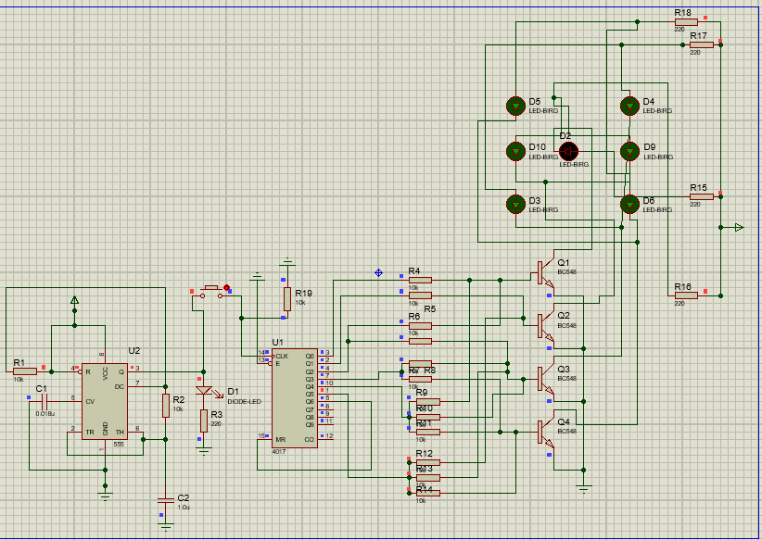
Circuit Diagram
OUTPUT
555 Timer Circuit
IC 4017 Circuit

Slide 11
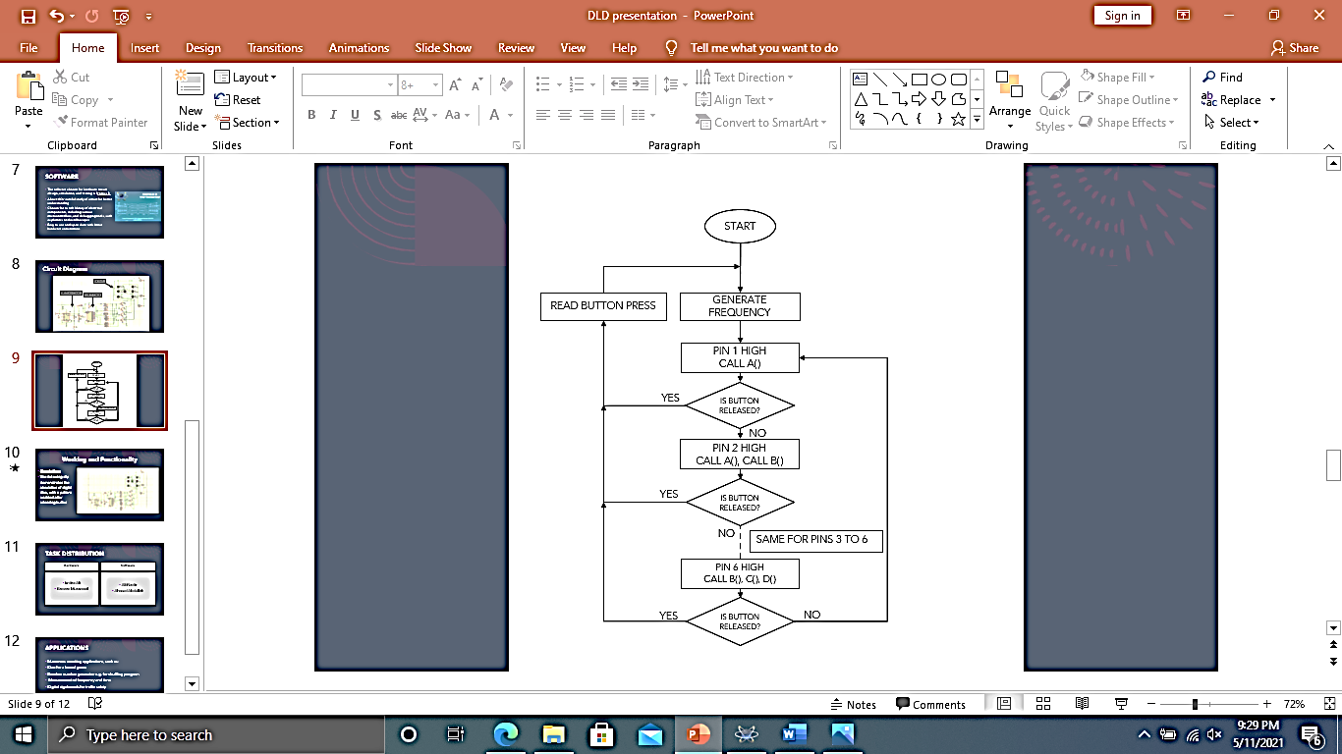
Flow Diagram
First pin enabled by default
Activate pins consecutively
Read button press after activating a pin
The counter loops until button is released

Slide 12
ALGORITHM
Timer IC feeds a clock pulse to 4017 counter IC
Clock frequency disturbs the counter to enable it
Initially, the circuit triggers first pin of the 4017 IC by default
This can be seen by illumination of central LED which indicates ONE
The program then checks for button release
If YES, the program prompts the user for input i.e. to detect the next button press
This allows the program to pause and display the last sequence of LEDs enabled
Else, if the button remains pressed, the circuit activates the second pin
Groups A, B, C and D represent resistors/LEDs arranged in parallel
The same check for pin 1 is reapplied and thus program loops through all 6 output pins
This is visualized by the LEDs cycling through all 6 patterns of the dice until button is released (1 through 6)

Slide 13
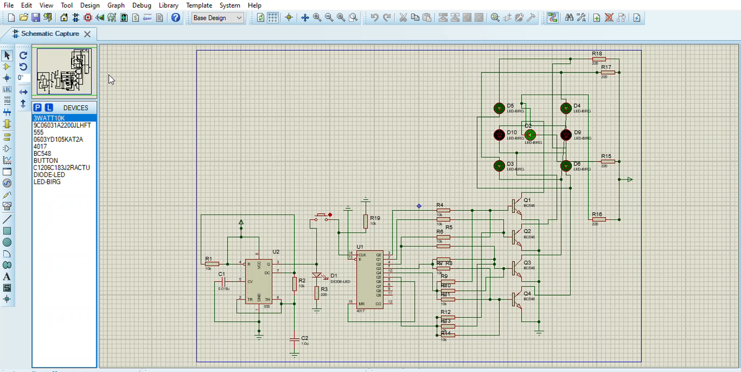
Working and Functionality
Simulation:
The following clip demonstrates the simulation of digital dice, with a pattern enabled after releasing button

Slide 14
TASK DISTRIBUTION
Hardware
Software
Imtiaz Ali
Kanwar Muzammil
Ali Nadir
Ahmed Abdullah

Slide 15
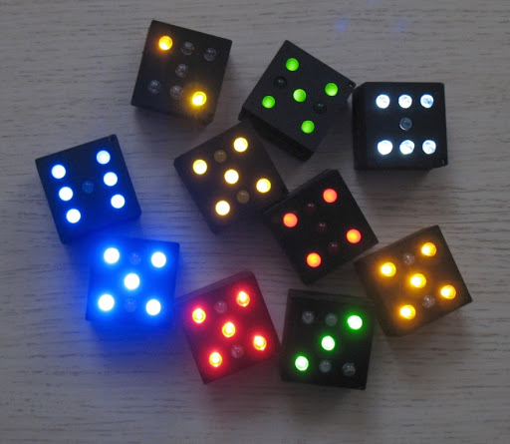
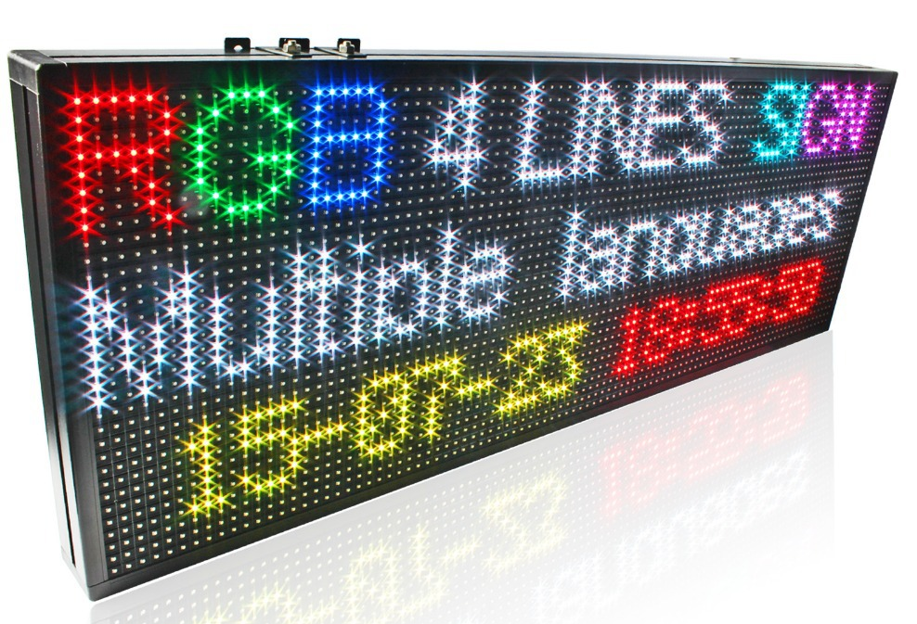
APPLICATIONS
Numerous counting applications,
such as:
Dice for a board game
Random number generator e.g. for
shuffling program
Measurement of frequency and time
Digital signboards for traffic safety

Slide 16
IN SHORT
System developed to cater to small scale board and card games
Allows for continuous dice rolls for extended periods
Purely unbiased and randomized results every time due to even frequency of an outcome’s occurrence
The algorithm can be extended to allow for larger scale applications such as digital signboards in airlines and traffic systems

Slide 17
CONCLUSION
This project greatly enhanced our understanding of combinational logic, microcontrollers, and flip flops along with their applications and also allowed us to brainstorm and explore alternative solutions to the problem proposed

